Slide 1


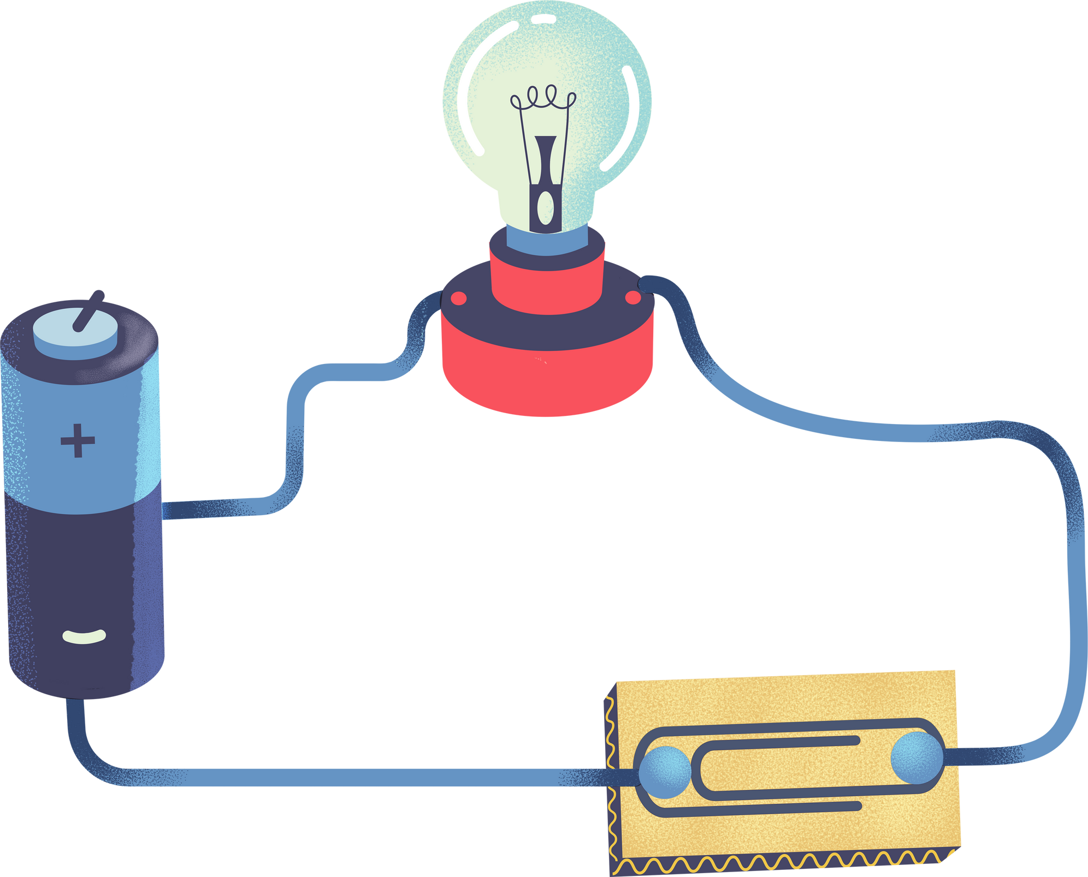
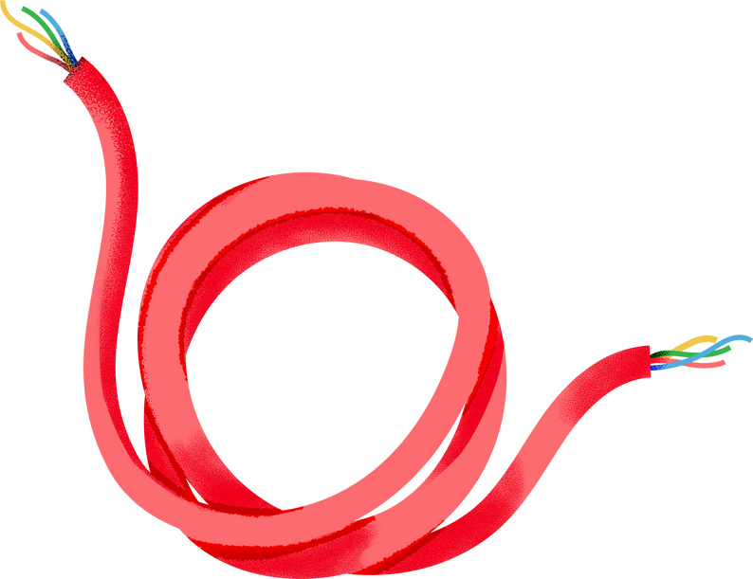

TYPES/CLASSIFICATIONS OF EMBEDDED SYSTEM
NAVARRO, ROD GERYK C.
CPE160P-4_A1_1Q2425

Slide 2
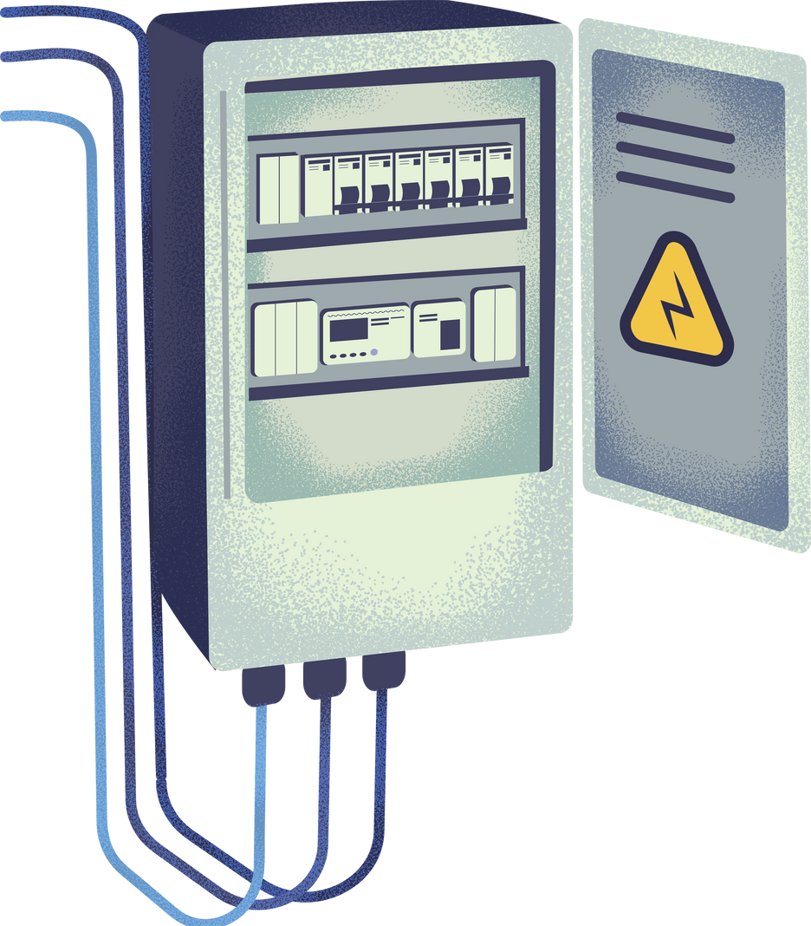
Overview of Embedded Systems
Definition: Embedded systems are specialized computer systems that perform dedicated functions within larger mechanical or electrical systems.
Components: Processor, memory, input/output interfaces, and software.
Purpose: High efficiency and reliability for specific tasks.

Slide 3

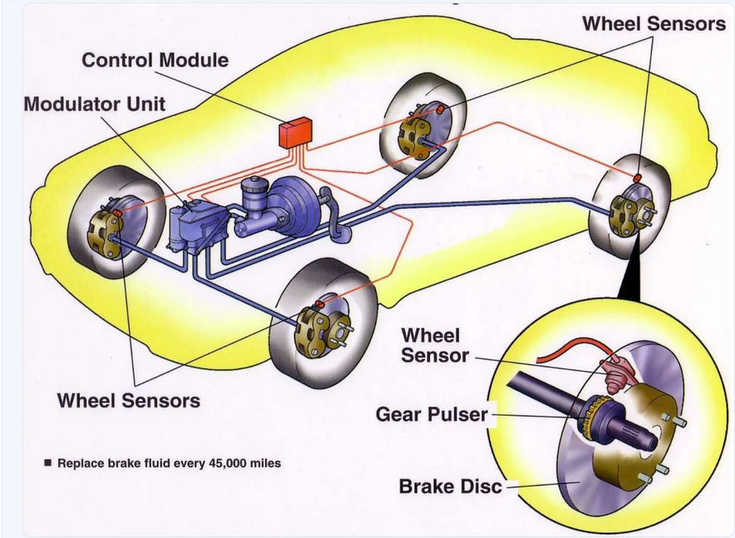
CLASSIFICATION 1 - BASED ON PERFORMANCE AND FUNCTIONAL REQUIREMENTS
Real-Time Embedded Systems
Example: Anti-lock braking system (ABS) in vehicles.
Explanation: ABS is a time-critical system that monitors wheel speed and applies braking pressure in real-time to prevent skidding. Delays in response could mean the difference between a safe stop and an accident.
Image showing car wheels connected to the braking system, highlighting sensors and the embedded control unit.

Slide 4
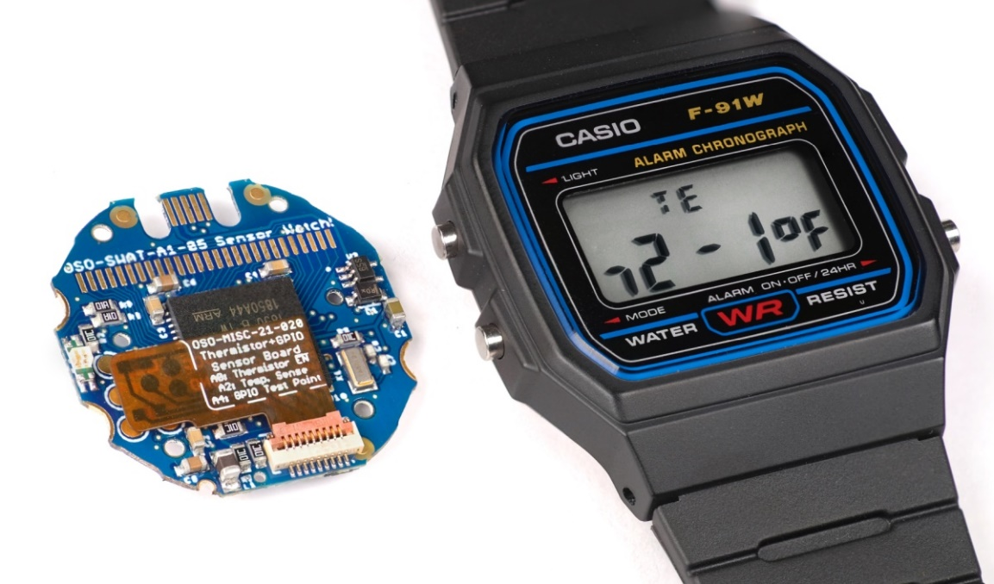
Classification 2 - Based on Complexity
Small-Scale Embedded Systems
Example: Digital watches.
Explanation: These systems use simple microcontrollers and require minimal software. They handle basic tasks like timekeeping, alarms, and light activation.
Image of a digital watch, annotated with its key features and internal microcontroller.

Slide 5
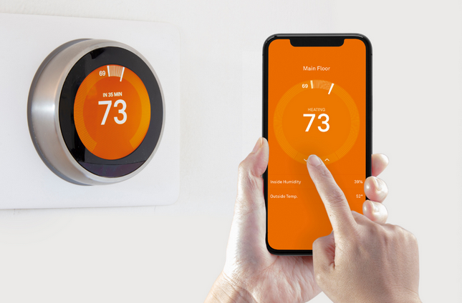





Medium-Scale Embedded Systems
Example: Home automation controllers (e.g., smart thermostats).
Explanation: These systems handle more complex operations, interacting with various sensors and outputs to adjust the home environment efficiently.
Image depicting a smart thermostat controlling HVAC systems and connected to a smartphone.

Slide 6
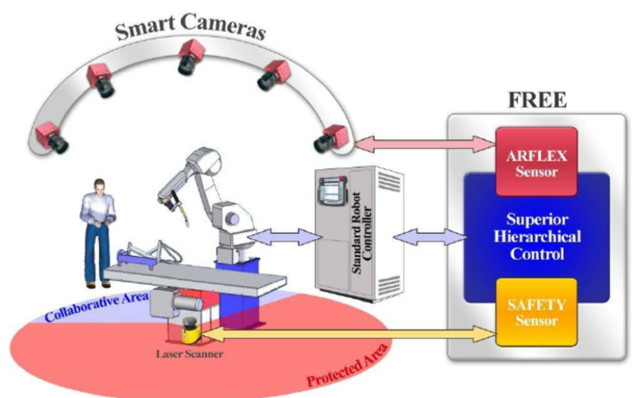
Large-Scale Embedded Systems
Example: Industrial robotic arms.
Explanation: These are complex systems involving sophisticated microprocessors and extensive software that enable tasks like assembly, welding, and painting with high precision in factories.
Image of an industrial robot at work, showing sensors and control panels.

Slide 7
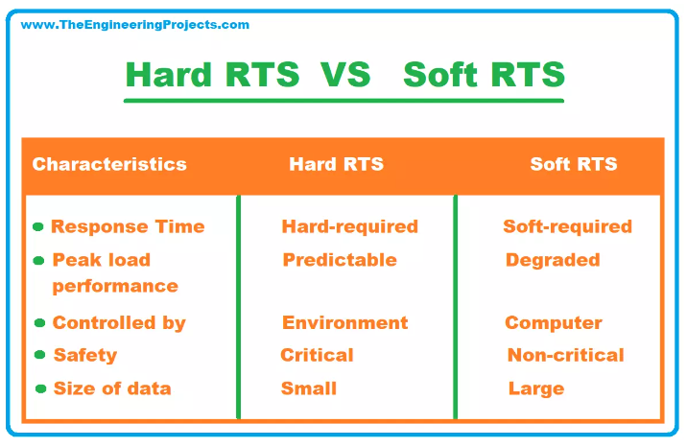
Classification 3 - Based on Timing Constraints
Hard Real-Time Embedded Systems
Soft Real-Time Embedded Systems

Slide 8
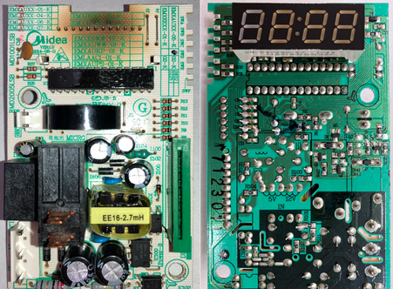
Classification 4 - Based on Microcontroller Types
1
Embedded Systems with General-Purpose Microcontrollers
Example: Microwave ovens.
Explanation: Use basic microcontrollers that handle user input, display time, and control the power level for heating food.
Image of a microwave control panel showing key parts connected to a microcontroller.

Slide 9
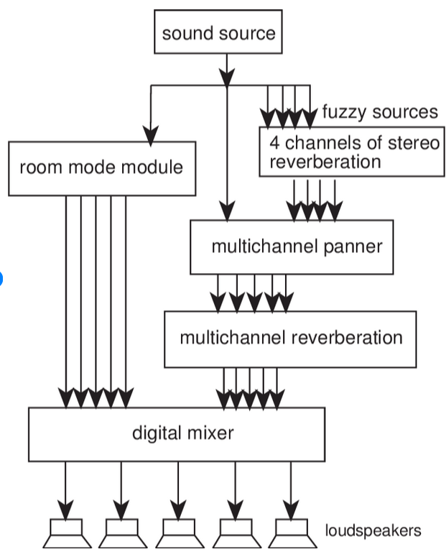
Classification 4 - Based on Microcontroller Types
2
Embedded Systems with Application-Specific Integrated Circuits (ASICs)
Example: Digital signal processing in audio amplifiers.
Explanation: These embedded systems are tailored for specific tasks like signal modulation and noise reduction.
A block diagram highlighting the audio signal path through an ASIC.

Slide 10
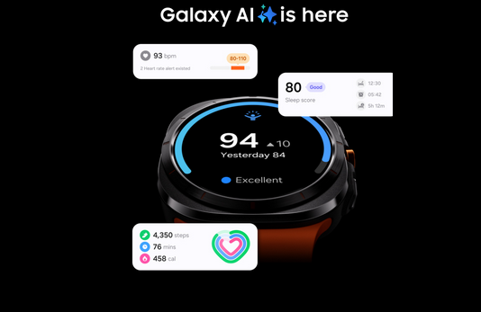
CLASSIFICATION 5 - BASED ON POWER AND ENERGY REQUIREMENTS
Low-Power Embedded Systems
Example: Smartwatches.
Explanation: Designed to consume minimal energy while offering functionalities like notifications, step counting, and heart rate monitoring.
Battery life indicator of a smartwatch with its energy-saving components highlighted.

Slide 11
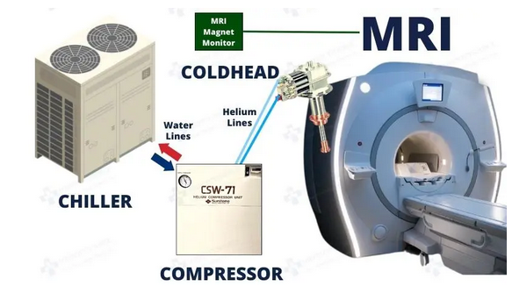
CLASSIFICATION 5 - BASED ON POWER AND ENERGY REQUIREMENTS
High-Power Embedded Systems
Example: MRI machines.
Explanation: These systems require significant power due to their high processing needs for imaging and data analysis.
Detailed MRI setup showing power components and embedded processing units.

Slide 12
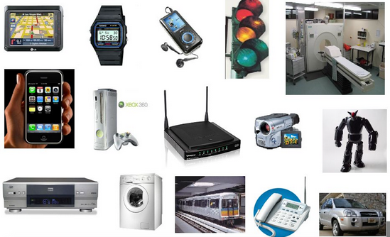
Summary and Takeaways
Recap: Types of embedded systems differ by performance, complexity, timing, microcontroller type, and power needs.
Real-Life Relevance: From healthcare to industrial automation, embedded systems are everywhere.

Slide 13


Before you go...
LET'S TEST YOUR KNOWLEDGE

Slide 14


What is the primary function of an embedded system?
A) General computing tasks
B) Performing a specific function within a larger system
C) Video gaming
D) Web browsing
Which of the following is an example of a real-time embedded system?
A) Digital camera
B) Microwave oven
C) Anti-lock braking system (ABS)
D) Smartwatch

Slide 15
Digital watches fall under which classification of embedded systems?
A) Real-time systems
B) Small-scale embedded systems
C) Large-scale embedded systems
D) High-power embedded systems
What type of embedded system is a smart thermostat?
A) Low-power embedded system
B) Small-scale embedded system
C) Medium-scale embedded system
D) Hard real-time embedded system

Slide 16
Which of the following best describes the characteristic of a hard real-time embedded system?
A) No strict time limits
B) Can handle minor delays
C) Must respond within a defined time limit
D) Operates with minimal power
An industrial robotic arm used in a factory is classified as which type of embedded system?
A) Small-scale embedded system
B) Real-time embedded system
C) Large-scale embedded system
D) Low-power embedded system

Slide 17
Which system is an example of a low-power embedded system?
A) MRI machine
B) Digital watch
C) Smartwatch
D) Robotic arm
Video streaming services fall under which type of real-time system?
A) Hard real-time system
B) Small-scale system
C) Soft real-time system
D) High-power system

Slide 18
What type of embedded system is used in microwave ovens?
A) ASIC-based embedded system
B) Small-scale embedded system
C) Real-time embedded system
D) Low-power embedded system
Which of the following systems uses an Application-Specific Integrated Circuit (ASIC)?
A) Digital watch
B) Video streaming device
C) Audio amplifier
D) Smart thermostat

Slide 19
What is the primary requirement of a hard real-time embedded system like a pacemaker?
A) Minimal power consumption
B) Non-critical response time
C) Guaranteed response within strict timing constraints
D) High storage capacity
Answer: C
An embedded system in an MRI machine is best described as:
A) Low-power and small-scale
B) Medium-scale and energy-efficient
C) High-power and complex
D) Real-time and portable

Slide 20
What type of system is characterized by simple microcontrollers and minimal software?
A) Large-scale embedded systems
B) Medium-scale embedded systems
C) Small-scale embedded systems
D) Real-time embedded systems
Which embedded system category best fits home automation controllers?
A) Large-scale embedded systems
B) Low-power embedded systems
C) Medium-scale embedded systems
D) Hard real-time systems

Slide 21
Which type of embedded system can tolerate minor delays in response time?
A) Hard real-time systems
B) Medium-scale embedded systems
C) Soft real-time systems
D) High-power embedded systems
Smartwatches fall under which classification based on power and energy requirements?
A) High-power embedded systems
B) Low-power embedded systems
C) Medium-scale embedded systems
D) ASIC-based embedded systems

Slide 22
What is the main role of a real-time embedded system in a vehicle's ABS?
A) Controlling the car's climate
B) Assisting with GPS navigation
C) Preventing wheel skidding during braking
D) Playing music
Which embedded system uses sensors to monitor heart activity and provide electrical stimulation?
A) Smart thermostat
B) Digital watch
C) Pacemaker
D) Audio amplifier

Slide 23
What classification would a digital signal processing system in an audio amplifier fall under?
A) Low-power embedded systems
B) ASIC-based embedded systems
C) Medium-scale embedded systems
D) Real-time embedded systems
What is an example of a system that must operate efficiently within a strict response time to ensure user safety?
A) Streaming service
B) Pacemaker
C) Digital watch
D) Smartwatch

Slide 24
Answer Key:
B
C
B
C
C
C
C
C
B
C
C
C
C
C
C
B
C
C
B
B

Slide 25

REFERENCES
https://www.geeksforgeeks.org/introduction-of-embedded-systems-set-1/
https://www.researchgate.net/publication/378127420_The_evolution_of_embedded_systems_in_automotive_industry_A_global_review
https://www.tomsguide.com/us/best-smart-home-hubs,review-3200.html
https://www.verywellhealth.com/pacemakers-what-you-should-know-1745231
https://www.theengineeringprojects.com/2021/06/real-time-embedded-systems-definition-types-examples-and-applications.html
https://liliputing.com/35-sensor-watch-crams-a-modern-microcontroller-into-a-classic-casio-wristwatch/
https://www.slideshare.net/slideshow/embedded-systems-in-automobiles-pptpptx/266089143
https://coolproatlanta.com/smart-thermostats-and-hvac-automation/
https://www.researchgate.net/figure/Schematic-overview-of-the-FREE-project-showing-the-use-of-both-measuring-sensors-to-teach_fig1_289477259
https://blog.stuffedcow.net/2024/06/microwave-failure-spontaneously-turns-on/
https://www.researchgate.net/figure/A-block-diagram-of-the-components-of-the-system-and-the-audio-signal-flow-The-sound_fig11_228597817
https://www.samsung.com/ph/watches/galaxy-watch/galaxy-watch-ultra-titanium-silver-lte-sm-l705fztaxtc/
https://homa-alem.github.io/teaching/ece_6501/
https://intechhouse.com/blog/software-vs-hardware/

